Slide 1
Utrjevanje za 2. PPZ
Project 1 6. razred
Units 2 & 3

Slide 2
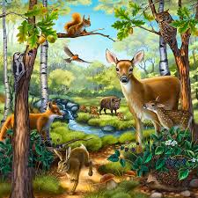
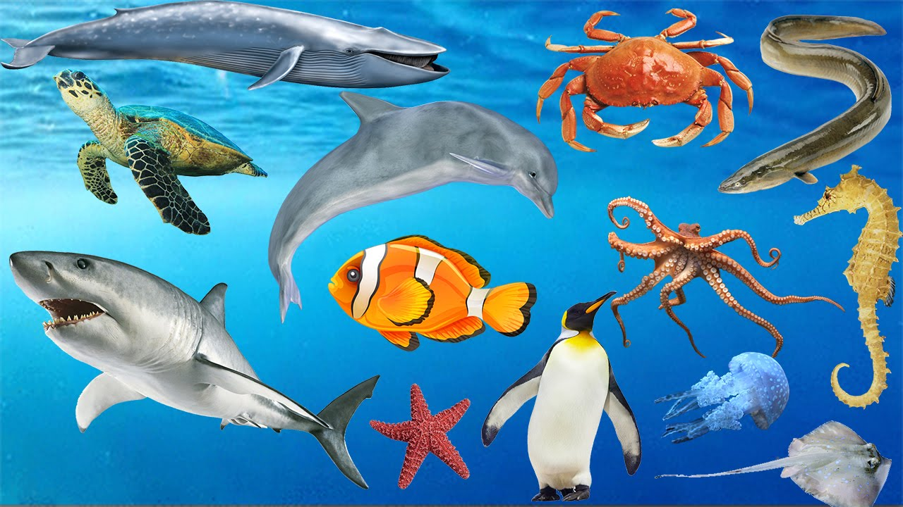
Name as many animals as you can.
ostrich
elephant
tiger
kangaroo
crocodile
crab
beetle
whale
eel
seahorse
horse
octopus
donkey
cow
sheep
goose
turkey
shark
starfish
penguin
rabbit
dog
chicken

Slide 3
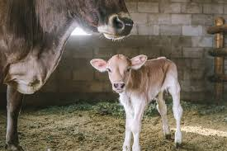
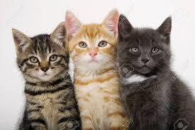
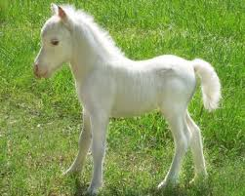
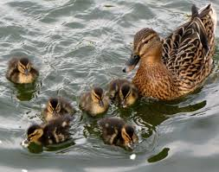
Look at the pictures and fill in.
A cow usually bears a single ___________.
Our cat has got three ______________.
Every time I visit Lipica I enjoy watching little ________________ jumping around.
Oh! Look at the mother duck with her ________________. They are so cute!
calf
kittens
foals
duckling

Slide 4
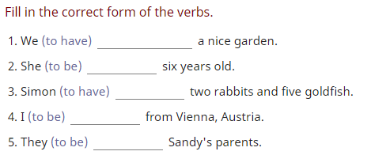
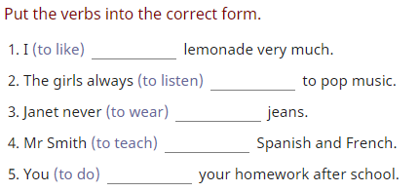
Present Simple A) B)
have
is
has
am
are
like
listen
wears
teaches
do

Slide 5
A) B)

Slide 6
A.
My father doesn‘t make breakfast.
They aren‘t eleven.
She doesn‘t write a letter.
I don‘t speak Italian.
Danny doesn‘t phone his father on Sundays.
B.
Do you speak English?
When does he go home?
Do they clean the bathroom?
Where does she ride her bike?
Does Billy work in the supermarket?

Slide 7
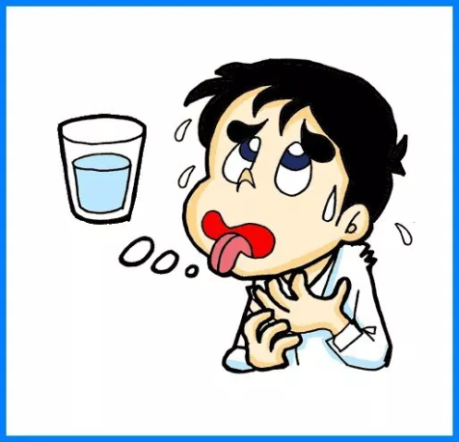
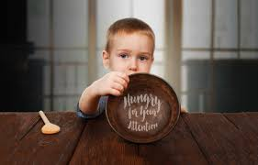
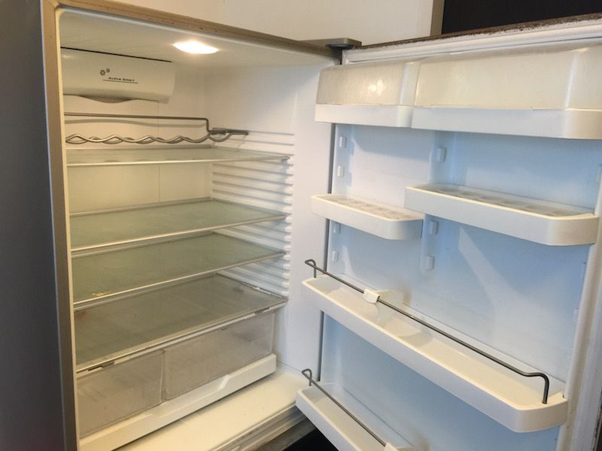
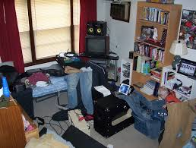
What must they do?

Slide 8
They must wash the dishes.
He must drink some water.
He must eat something.
They must buy some food.
He must tidy his room.

Slide 9
What‘s missing? (subject and object pronouns)
Where is the boy going? _____ is going to school.
Mary loves to cook. _____ likes baking too.
Mary and Jane are going to the store. Please ask _____ to pick up some bread.
You and I are going to the movies. _____ should go out to eat first.
Jack and Jill went up the hill. ____ like going up hills.
Jack and Jill are in town. I saw _____ in the store yesterday.
That big black spider bit me. _____ bit me on my hand.

Slide 10
He
She
them
We
They
them
It

Slide 11
What are they doing? (Present Continuous)

Slide 12
Mr Walker is walking the dog.
Georgia is taking photographs.
Hannah and Ruby are rollerblading.
Mrs Giggs and Suzy are feeding the ducks.
Nathan and Sam are swimming/playing in the pond.
Zach and Damien are playing with the ball.
Gabriel is sleeping.
Austin is reading a magazine.
Maisie and Beth are eating ice-cream.
The park keeper is yelling at the people.

Slide 13
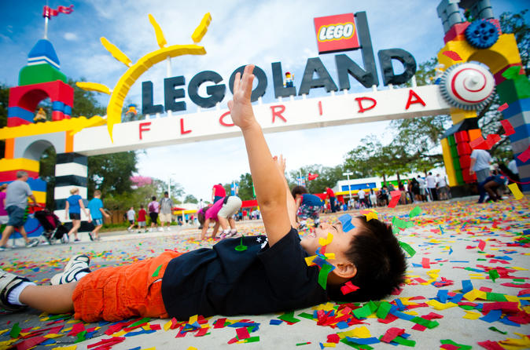
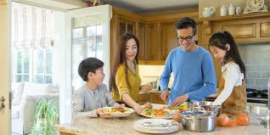
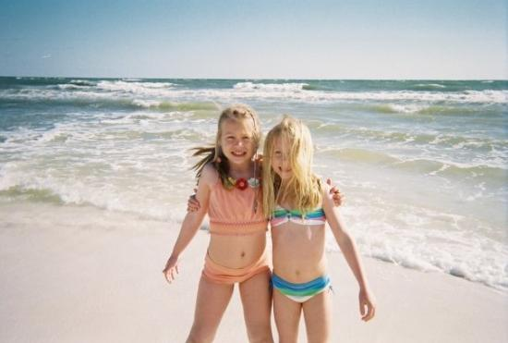
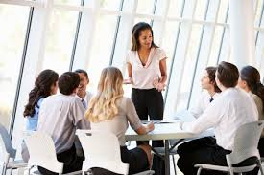
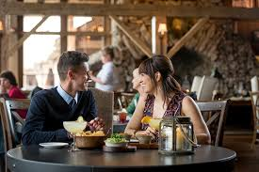
Where are they?

Slide 14
He is in the park.
He is at the theme park.
They are at home.
They are at work.
They are in the restaurant.
They are on holiday./They are on the beach.

Slide 15
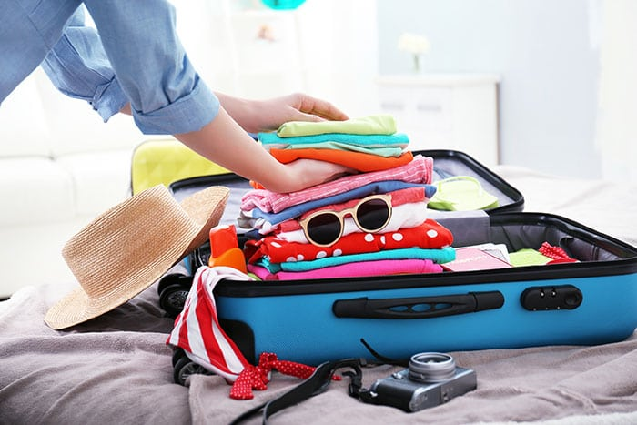
What do you need to pack, when you …
… go to Portorož for a summer vacation (poletne počitnice)?
… travel abroad (v tujino)?
… go to a spa (toplice) during the winter holidays?
… go to a school camp (šola v naravi) Planinka?
A towel, swimsuit, sunglasses, sun lotion, flip flops, money…
A passport, money, ID, suitcase, clothes, …
A towel, money, a book, warm clothes, a tracksuit, a rucksack, boots,…
A towel, bedsheets, clothes, a book, a pencil-case, a notebook,…

Slide 16
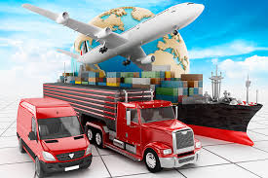
Transport
What are the ways of travelling on water? Name at least 3.
How can you travel, when you want to visit places in Slovenia? Name at least 6.

Slide 17
By ferry, by boat, by ship
By bus, by train, by bike, on foot, by car, by horse …

Slide 18
Put the verbs in Present Simple or Continuous

Slide 19
am writing,
walks,
is going,
go,
goes,
are playing,
cries,
am not doing,
Does he watch

Slide 20
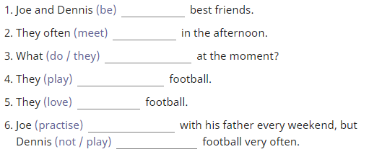
Extra practice

Slide 21
is,
has,
wears,
is wearing,
likes,
plays,
are,
meet,
are they doing,
are playing,
love,
practises,
doesn‘t play

