Slide 1

REVISION (UNITS 3 & 4)

Slide 2
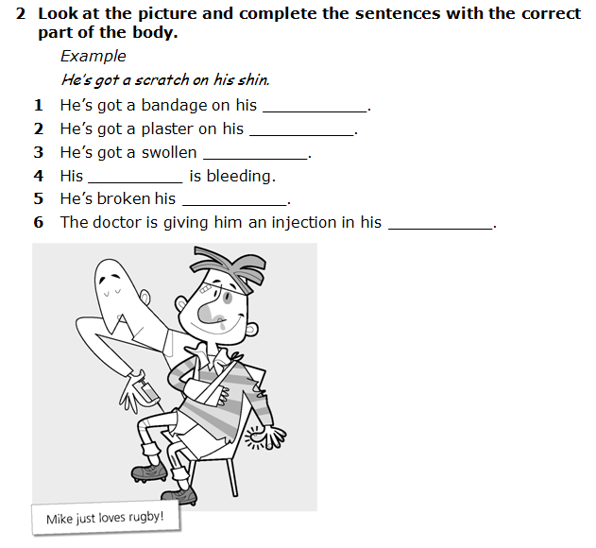

Slide 3
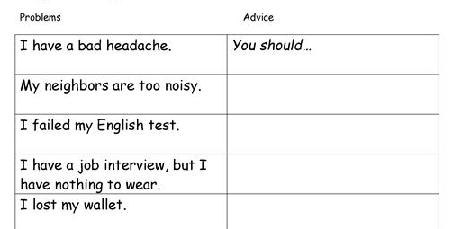
GIVE ADVICE.

Slide 4
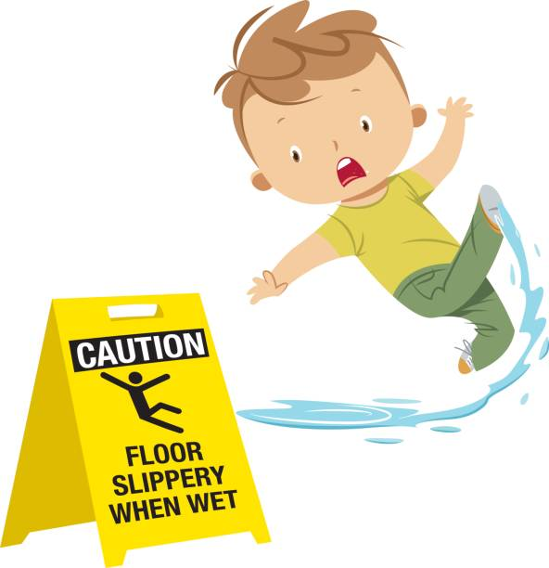
What might happen if…
… you use headphones with loud music on while crossing the street?
…you sunbathe with no sunscreen?
… you run on slippery floor?
… you forget your bag in a restaurant?

Slide 5
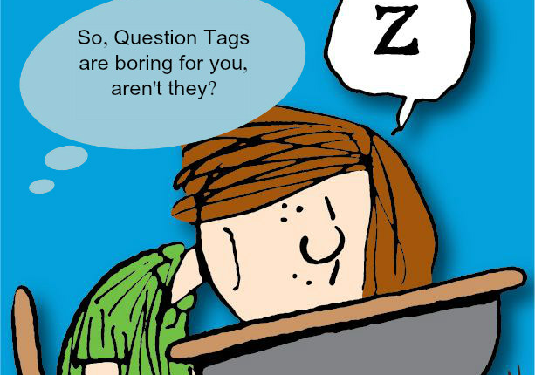
QUESTION TAGS
You can’t hear me, ________________?
He loves judo, ______________?
I’m good at dancing, ________________?
Let’s go out tonight, _______________?
They haven’t arrived yet, ________________?
You won’t tell anyone, _________________?
Dora came third in the competition, _____________?

Slide 6
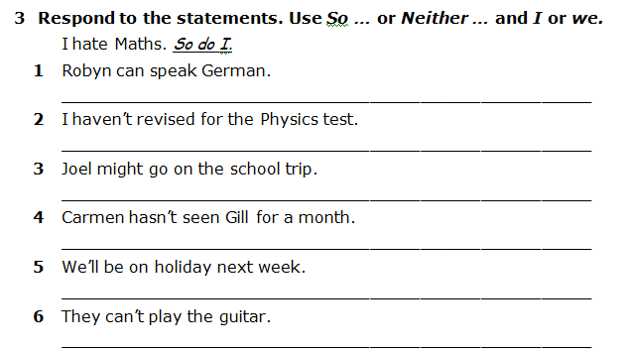

Slide 7
RELATIVE PRONOUNS & CLAUSES
1.-A coach is a person …………. helps you train.
2.-That’s the politician ……….. daughter got married in Miami.
3.-A court is a place …………. people play tennis.
4.-That is the race ……………. millions of people watch.
5.-1992 is the year ………… the Olympics were held in Barcelona.
6.- I have a friend ………. father is working in the local hospital
7.-You will never forget the day …………. you were born.
8.-There’s the man ………… car got stolen last night.
9.-I know a man ………. coaches tennis if you really want to play.

Slide 8
Join the sentences. use relative pronouns.
1. I know a chef. He makes 100 types of pasta.
2. I read a book. It explained how to make films.
3. This is the garden. He usually walks his dog here.
4. Here is the boy. The teacher was looking for him.
5. I remember the day. You had a surprise party then.

Slide 9
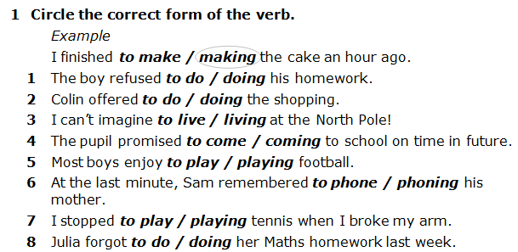

Slide 10
GERUND OR INFINITIVE? FILL IN.
David has always dreamed of _________________ an actor. (be)
He apparently has trouble _____________ on time. (arrive)
They arranged for us ______________ at the café. (meet)
She continued _______________ for the whole afternoon. (scream)
We always stop _____________ a rest on our way to the seaside. (have)
Mary stopped ______________ nightmares after she’d seen a psychiatrist. (have)

Slide 11
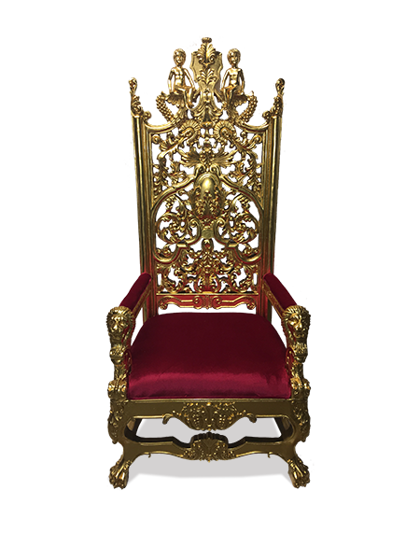

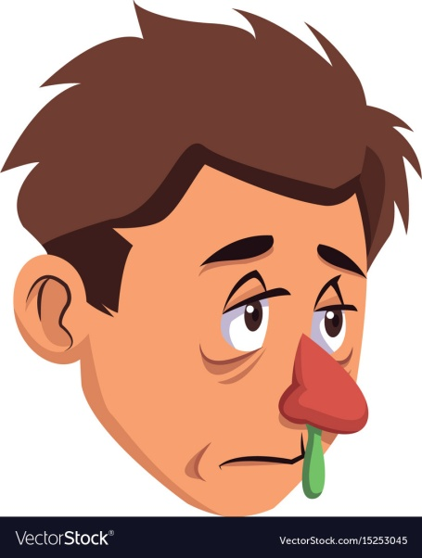
VOCABULARY
Write the word (part 1) or definition (part 2). In part 3 you label the picture.
* inflicted with a wound; injured: _________________
* a long stick with a crosspiece at the top, used as a support under the armpit by a lame person: ________________________
* an allergy caused by pollen or dust in which the mucous membranes of the eyes and nose are inflamed, causing running at the nose and watery eyes: ________________
ARMOUR: _________________________
PRESCRIPTION: ______________________
BURGLAR: _______________________

Slide 12
Choose the correct adjectives (-ed, -ing)
1-Yesterday I went to the cinema. The film was so ______ that I felt ____________. (scared-scaring)
2-Please, be quiet! You’re so _____________ that at the end of the day I feel very _________(tired-tiring)
3-When I was going to pay the bill, I noticed that I didn’t have any money. It was an_________ situation and I really was ___________. (embarrassed-embarrassing)
4-The book I have just read is so __________that I am ________ in watching the film. (interested-interesting)
5-London is a very _____________town. I’m very_________ because I was offered a trip to visit this place. (excited-exciting)
6-I was _____________ when I saw my boyfriend with another girl. It was a __________ experience. (shocking-shocked)
7-I feel ___________ at work. I consider my job ___________.(boring-bored)

