Slide 1
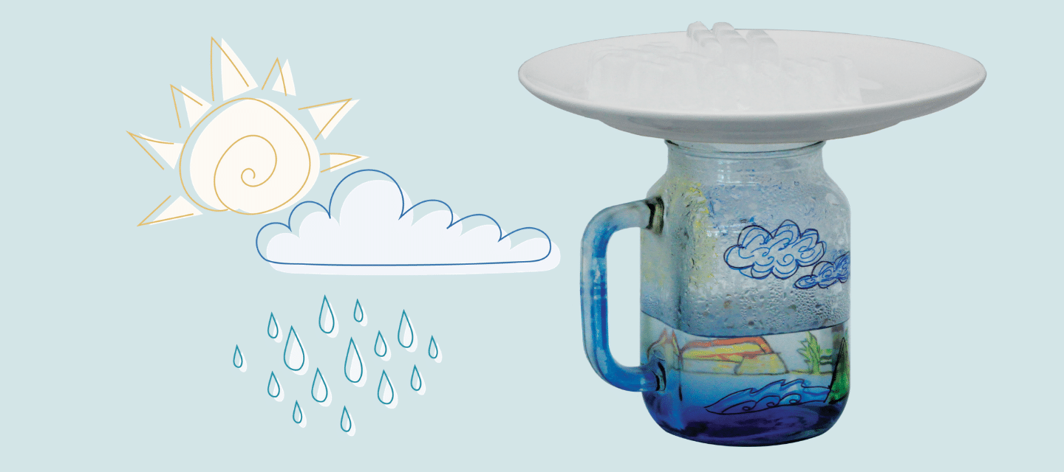
WATER CYCLE
Class 3

Slide 2
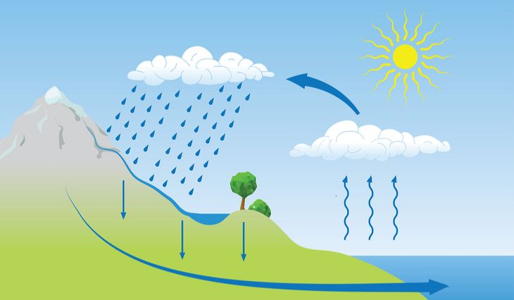
CONDENSATION
PRECIPITATION
EVAPORATION

