Slide 1
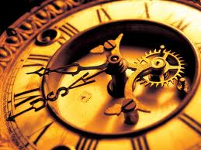
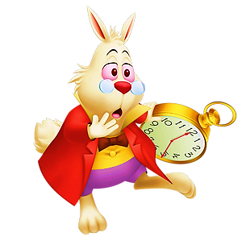
Analog and digital clocks

Slide 2
What has two hands and a face but no arms and legs?

Slide 3
A CLOCK!

Slide 4
O’CLOCK
A QUARTER
TO
PAST
A QUARTER
REMEMBER!
NEXT
HALF-PAST

Slide 5
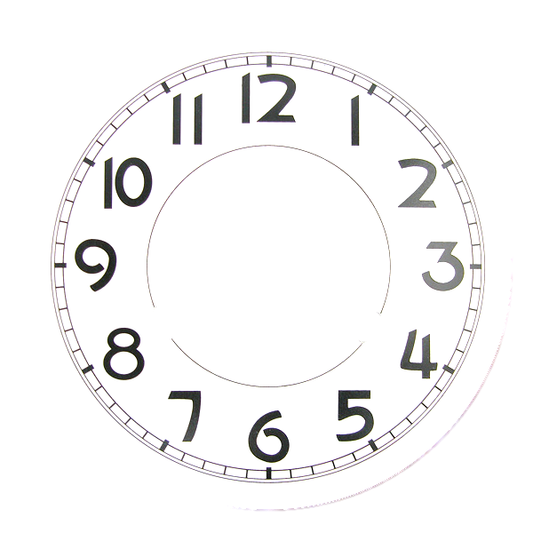
What’s the time?
It’s …
NEXT
twenty-five
to twelve
seven o’clock
twenty-five past twelve

Slide 6
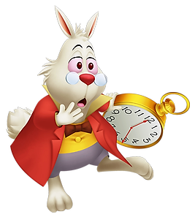
What’s the time?
It’s …
NEXT
twenty past nine
a quarter
to four
twenty
to nine

Slide 7
What’s the time?
It’s …
NEXT
ten to one
ten past one
five past two

Slide 8
What’s the time?
It’s …
NEXT
twenty-five
to three
twenty-five past three
a quarter
past five

Slide 9
What’s the time?
It’s …
NEXT
a quarter
past three
a quarter
past nine
a quarter
to three

Slide 10
What’s the time?
It’s …
NEXT
half-past eight
twenty to six
twenty past six

Slide 11
What’s the time?
It’s …
NEXT
ten past four
twenty past ten
ten to four

Slide 12
What’s the time?
It’s …
NEXT
one o’clock
five to twelve
five past twelve

Slide 13
What’s the time?
It’s …
NEXT
twenty to nine
twenty past nine
a quarter to eight

Slide 14
What’s the time?
It’s …
NEXT
a quarter
past seven
a quarter
to seven
twenty-five
to three

Slide 15
What’s the time?
It’s …
NEXT
twenty-five
past eleven
twenty-five
to eleven
five to seven

Slide 16
What’s the time?
It’s …
NEXT
five to six
half-past eleven
five past six

Slide 17
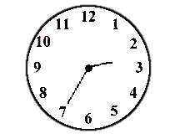
What’s the time?
It’s …
twenty-five
to three
thirty-five
to two
NEXT

Slide 18
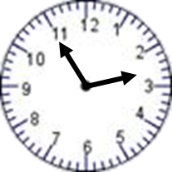
What’s the time?
It’s …
fifty-five to two
five to three
NEXT

Slide 19
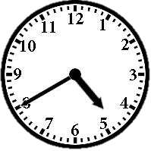
What’s the time?
It’s …
twenty to five
twenty to four
NEXT

Slide 20
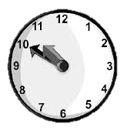
What’s the time?
It’s …
fifty to ten
ten to eleven
NEXT

Slide 21
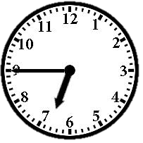
What’s the time?
It’s …
a quarter
to six
a quarter
to seven
NEXT

Slide 22
GOOD JOB!

